Slide 1
GA DOAS Human Resources Administration (HRA)
Retention Study Findings & Recommendations
June 29, 2023
Notes:
Al to kickoff the presentation

Slide 2



Agenda
1
Current Workforce Trends and Ongoing Efforts
Project background, current workforce challenges, and ongoing efforts within Georgia
2
Retention Study Insights and Recommendations
Key findings, insights, and recommendations from the Retention Study including results of the employee engagement survey, pilot exit survey, and focus group sessions
3
Next Steps
Overview of how HRA will leverage insights from the Retention Study findings to create a path forward
Notes:
[Al] Today we will walk you through the current national and specific Georgia workforce trends and what we’re currently doing to address these challenges.
We will then go through the findings and recommendations of our retention study and we’ll wrap up our presentation with next steps.

Slide 3

Work Plan
Current Workforce Trends and Ongoing Efforts
Notes:
[Al] What we’re seeing in Georgia related to workforce challenges are reflected in national trends.

Slide 4
Top Reasons Nationally Around Attrition
Based on Pew Research in 2021, below shows the top reasons workers are seeking employment elsewhere. The top two reasons are also reflected in our survey results for Georgia.
Specific reasons for high turnover are largely unknown at the State of Georgia, as 78% of terminations are coded as generic "Resignation".
Low pay was the top reason US workers quit during the Great Resignation of 2021
…and the pace of quits has slowed only slightly in 2022
Quitters are likely getting different (presumably better) jobs
78%
of those who quit a job say they are still employed
Data from State of Georgia TeamWorks Fiscal Year 2022 Workforce Report
¹ Pew Research Center The Great Resignation: Why workers say they quit jobs in 2021 | Pew Research Center
Notes:
[Al] Nationally, individuals are leaving their jobs because of low pay, limited advancement opportunities, and more. These top two reasons for attrition are also reflected in our employee engagement survey.
Currently, within our PeopleSoft data, specific reasons for turnover are largely unknown. Around 78% of our terminations are coded as generic "Resignation“ without additional context or information.

Slide 5


Georgia’s Current Efforts to Address Workforce Challenges
The State of Georgia’s workforce challenges are experienced across State agencies. Given today’s talent crunch, Georgia is exploring ways to enhance retention along with addressing recruitment.
Current Workforce Efforts
Desired Outcomes
1
Standing up Workgroup Strategies Initiative Workgroups (WSIW) to develop and implement strategies to boost interest in state jobs, increase talent pipelines, and implement solutions for the groups and ultimately, enterprise-wide.
Conducting a Retention Study to explore drivers of retention and attrition across State agencies to develop and prioritize recommendations.
Conducting a Statewide Review of Minimum Job Qualifications through a review of job qualifications requiring a college degree and implement changes to tap into non-degree workers with experience-based qualifications and increase diversity in the state government workforce.
Establishing a New Recruiting and Retention Unit within HRA to provide additional assistance to HR departments and address the State’s workforce challenges.
  Streamline and innovate the ways the State identifies potential talent
  Prepare employees with the skills and capabilities for success on the job
  Keep them employed, engaged, and growing throughout a meaningful career with the State
2
3
4
Notes:
[Al] To address our current workforce challenges, the State has taken a multifaceted approach to boost retention and recruitment across State agencies, showing their commitment to investing in the workforce of tomorrow.
First, we established the Workgroup Strategies Initiative Workgroups to boost interest in specific job types and test recruitment solutions that could be scaled organization-wide.
This retention study explored enterprise-wide drivers of retention and engagement. In order to build upon the WSI workgroup efforts, additional analysis and focus groups were performed to further understand needs and challenges facing those employees.
Additionally, the State has been conducting a statewide review of minimum job qualifications and has established a new recruiting and retention unit.
The findings and recommendations from this retention study can be used to enhance all of these efforts to keep employees employed, engaged, and growing throughout a meaningful career with the State.

Slide 6

Work Plan
Retention Study Insights and Recommendations
Notes:
[Al] I’ll hand it to our Deloitte team to walk through our findings from the Retention Study.
[Natalie] Thank you Al.

Slide 7
Retention Study Project Approach
The three-sprint effort assessed and produced a Retention Study for HRA to better understand and respond to the State of Georgia’s workforce, culture, and drivers of attrition and retention.
Our Approach
Sprint 1: Discover
Sprint 2: Design
Sprint 3: Develop
Intake and synthesize job & retention data for key workgroups
Conduct additional external empirical research
Schedule and host supplemental focus groups and interviews
Build key recommendations and strategies to enable retention within key workgroups
Conduct empirical research to address high rates of employee turnover
Finalize lab agenda, timing, and attendees
Host Executive Leadership Focus Group to conduct initial review and prioritization of recommendations
ACTIVITIES
Findings Report
Report containing descriptive and analytical insights on the current State workforce.
Retention Study Initial Findings & Recommendations Report
Key recommendations and strategies to support retention and engagement based on data analysis from Sprint 1.
Executive Leadership Focus Group Outputs
Conduct an immersive, in-person executive leadership focus group to examine study findings and review recommendations.
DELIVERABLES
Notes:
[Natalie] First off, we wanted to walkthrough our approach to this 10-week Retention Study. Our first Sprint was all about data collection and analysis. We analyzed PeopleSoft data, designed and deployed the employee engagement survey and analyzed those results. We also conducted 13 focus groups to gather additional qualitative insights from employees.
We used all of this information to drive our recommendations during Sprint 2 and shared our findings with the Executive Leadership during a focus group at the end of May.
So let’s dive into the data!

Slide 8





Summary Insights: HR Data Analysis
The following data points summarize high level findings across analysis of PeopleSoft data.
50,850
Employees
23.0%
FY22 Annual Turnover
6 Years
Average Tenure
At Separation
9 Years
Average Tenure of Employees
60%
Of employees are Generation X or older
24.8%
Executive Branch Employees Eligible for Early Retirement within 5 Years
6.3%
Higher than the State’s entire Baby Boomer employee population
39%
Of employees have a Bachelor’s Degree
or Above
On average, the State of Georgia pays its employees more than the midpoint of their pay grade.
There is limited discrepancy between salaries within the two major State pay grades.
1.04
GA Overall Average
Compa-Ratio
Notes:
[Natalie] From our PeopleSoft analysis, here are our summary insights.
A few data points to highlight here:
60% of State employees are part of Generation X or older and as Al mentioned earlier, almost a quarter of executive branch employees are eligible for early retirement in 5 years. That is equivalent to losing all of your Baby Boomer employees and more.
We also calculated tenure across the state, which is approximately 9 years, while those that have left, have had an average tenure of about 6 years.
Finally, we did an analysis of the State’s pay plan to see how employees were paid within their pay grades and on average employees are getting paid more than the midpoint of their pay grade. We looked at the two main pay plans within the State, the state-wide pay plan and the law enforcement pay plan.

Slide 9

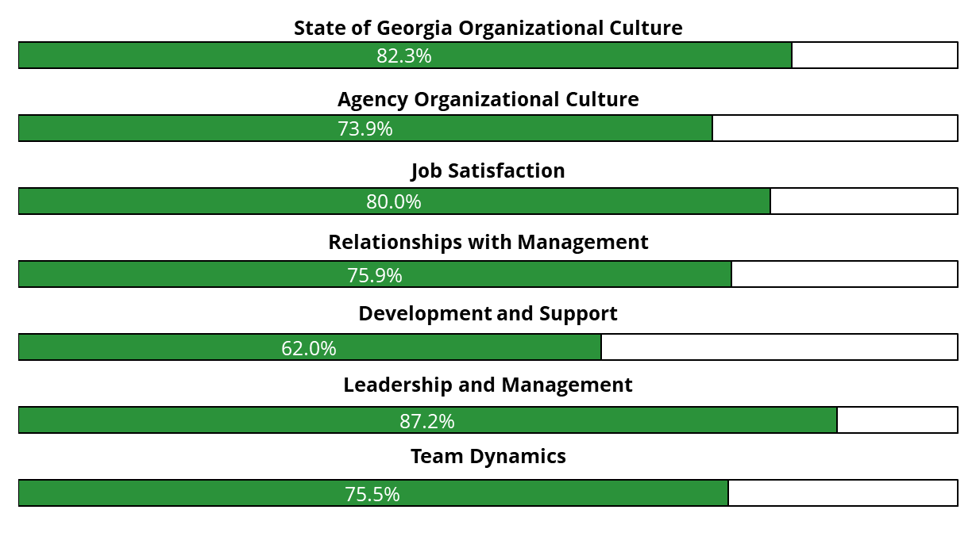



Summary Insights: Survey Results
Results of the employee engagement survey are summarized below and includes participation statistics, agreements across Likert scale questions to positive statements organized by theme, and top 3 reasons identified around attrition, re-employment, and retention.
Participant were asked their level of agreement (Agree and Strongly Agree shown below) to positive statements related to the following themes:
12,433
Employee Responses
56.5%
Of Participants were Generation X or older
62
Agencies Represented*
63.6%
Of participants had a Bachelor’s degree or higher
Top 3 Reasons For:
63%
Intend to stay employed with the State for 6+ years
11%
New-hires with tenure ≤ 1 year
Attrition:
Re-employment:
Retention:
Compensation
Limited Career Opportunities
Negative Work/Life Balance
Positive Work/Life Balance
Leverage Skills & Interests
Benefits
Positive Work/Life Balance
Leverage Skills & Interests
Benefits
*Technical Colleges (TC) are considered independent agencies for this calculation
Notes:
[Natalie] Our second analysis was the results of the employee engagement survey. We had over 12,000 responses with about 62 agencies represented. What we found was that the majority of participants indicated that they intended to stay with the State for 6 or more years which is very promising.
We were also able to highlight top reasons for attrition and retention along with overall sentiment across a variety of aspects of being a state employee. A few items of note were strong alignments to mission and vision of the State and their specific agency, understanding of their role, and desires for professional development. Compensation was the number one reason why State employees would consider leaving while experiences with positive and negative work life balance impacts employees’ intentions to stay or leave respectively.

Slide 10











Summary Insights: Focus Group Results
In addition to data analysis and survey results, the team conducted 13 focus groups. High-level findings from across these focus groups are summarized below.
Drivers of Retention:
Strong Connection to Mission | Remote Work Options & Work/Life Balance | Retirement & Benefits Satisfaction
Limited Professional Development Opportunities | Noncompetitive Compensation | Poor Management Experience
Lack of Leadership Transparency | Outdated Technology & Processes | Employee Burnout
1,485
Employee opted in to participate
81
Participants
Drivers of Attrition:
29
Agencies Represented*
69%
Have considered outside employment in the last 12 months
Additional Focus Areas of Participants:
8.5 Years
Average tenure of participants
60%
Would find new roles/transfer agencies before leaving State employment
*Technical Colleges (TC) are considered independent agencies for this calculation
Notes:
[Natalie] Moving on to our focus group results. We conducted 13 focus groups with employees from 29 agencies. What was very exciting for us to see was that over 1000 employees opted-in to be part of the focus groups which signals good level of engagement across the State.
A few items from the focus group sessions to highlight here:
There is a strong connection to mission and impact of the work that the State is doing across all the agencies
Work life balance and flexibility are key drivers for folks staying with the State although there are some areas of employee burnout
There were also experiences with managers and supervisors that drove employees to leave in the past or transfer agencies

Slide 11

Summary Insights: Pilot Exit Survey Results
The team conducted an Employee Exit Survey pilot to gather more insight as to why employees are ending their employment with the State. Employees selected all applicable attrition factors.
Selected Attrition Factors
16
Employees
60%
Of employees are Generation X or older
8
Agencies Represented
Notes:
[Natalie] During our project we also piloted an employee exit survey. 16 employees completed this pilot and they were asked to indicate all of the reasons why they were leaving State employment. The top three reasons shown here are compensation, a shift in career, and limited opportunities for career advancement.
With all of this data analysis and insights, what does this mean for the State?

Slide 12




Recommendations Across the Talent Journey
Based on the information collected throughout the Retention Study, the team developed 14 recommendations for the State of Georgia to consider.
attract
Design employer brand strategy with mission and impact
at the center
Expand talent sourcing to include nontraditional populations
Review compensation philosophy that includes regular compensation and benefits analysis and transparent communications
Redefine/define job architecture and requirements and expand successful apprenticeship/internship programs
Modernize technical infrastructure to support current and future work demands
engage
Standardize and expand opportunities for hybrid and remote work
Increase change management and communication efforts to elevate transparency
Conduct regular employee engagement activities to gather ongoing employee sentiment
Develop accessible reporting mechanisms and escalation processes
develop
Design pre-management and management training programs
Establish Employee Training and Continued Education Programs
Formalize role progression and expand rotational programs
Define State-wide desired outcome of performance management processes to develop uniform evaluations and encourage ongoing feedback
Establish a succession planning framework
Notes:
[Natalie] Our team developed the following 14 recommendations across the talent journey – from Attract, Engage, to Develop. We won’t go through details for all 14 but I did want to highlight a few key ones. We’ll also have details of each of these recommendations at our table during the rotations so please visit us there if you’d like more information.
First in the attract bucket – designing an employer brand strategy by incorporating mission and impact into messaging. That was the number one reason why folks are still employed with the state – the impact they are having on Georgians.
Also, reviewing the State’s compensation philosophy and develop communications that highlight all of the existing benefits that employees have access to.
In the engage bucket – looking to standardize and expand opportunities for hybrid and remote work. As you saw in our data, work life balance is a key factor for folks staying or leaving State employment. Also to continue to conduct regular employee engagement activities across the state, such as the engagement survey and focus groups we had.
Finally in the develop bucket – designing pre-management and management training programs and establishing a succession planning framework. We heard a lot of varied experiences with management and desire to have more support for management training. Additionally, as we have mentioned, retirements across the state is occurring and having an established succession planning framework will help to identify and develop leaders who can fill roles left by these retirements.
As mentioned, we’ll have additional details of these recommendations at our table so please stop by. And I’ll hand it back to Al for next steps for this effort.

Slide 13

Work Plan
Next Steps

Slide 14

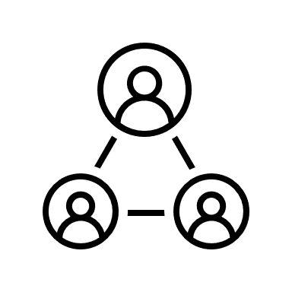

Gathering Additional Feedback
HRA will continue to socialize findings from the employee engagement and exit survey, focus group results, and subsequent recommendations and actions across the State to gather additional feedback from various stakeholder groups.
HRA will continue to socialize findings from:
Employee Engagement Survey A State-wide* survey assessed employees’ perspectives on culture, engagement, and retention. | Exit Survey Pilot An exit survey was piloted during the retention study and was incorporated into agency’s offboarding process to capture demographics of employees leaving and key drivers of attrition. | Focus Groups 5 WSIW, 9 workforce-wide, 1 executive leadership focus groups were conducted to provide context around retention drivers. | Recommendations and Actions Based on data analysis of the employee engagement and exit survey, and focus group results, 14 recommendations were developed.
*The survey participants are limited to the 62 agencies.
Notes:
[Al] As you can see, we have done a lot in the past 10 weeks to gather data and analyze all this data.
HRA is planning to continue to socialize findings and gather feedback on the data and recommendations presented.
Thank you!

